Slide 1
Mobile-Commerce Development
Lesson
Broadcast Receiver
Lecturer:
Tran Duy Thanh, Phd
Nguyen Quang Phuc, Msc
Email: thanhtd@uel.edu.vn
Blog: https://tranduythanh.com
Phone: 0987773061

Slide 2
Lesson Objective
Students understand Broadcast Receiver
Register and unregister a Broadcast Receiver
Use Broadcast Receiver for listening Wi-Fi changing
Use Broadcast Receiver for listening SMS coming
Do custom Broadcast Receiver

Slide 3
Outlines
Introducing Broadcast Receiver
Using Broadcast Receiver
Custom Broadcast Receiver

Slide 4
1. Introducing Broadcast Receiver
Broadcast Receiver is a component that helps spread information in the system and only registered applications receive the information.
Broadcast Receiver helps registered applications listen to system events and status (Wi-Fi connection status, charging, incoming messages, etc.) emitted through Intent.
Broadcast Receiver can be customized to transmit information according to the programmer's intentions.

Slide 5

1. Introducing Broadcast Receiver
Intent
Intent
Wi-Fi availability
Manifest / Java code
Battery Low
Broadcast Receiver
Intent
Intent
Incoming Call
Bluetooth device connected
Intent
Intent
Listen …
Incoming SMS
Charger (dis)connected
.…
Some events commonly occur in Android

Slide 6
2. Using Broadcast Receiver
Register
BroadcastReceiver receiver = new BroadcastReceiver() { @Override public void onReceive(Context context, Intent intent) { //Todo something …. } };
Method 1: register in Java code
protected void onResume() { super.onResume(); IntentFilter filter = new IntentFilter(ACTION); registerReceiver(receiver, filter); }
protected void onPause() { super.onPause(); unregisterReceiver(receiver); }

Slide 7
2. Using Broadcast Receiver
Register
Method 2: register in Manifest
public class MyReceiver extends BroadcastReceiver { @Override public void onReceive(Context context, Intent intent) { //Todo something …. } }
<receiver android:name=".MyReceiver"> <intent-filter> <action android:name="android.provider.Telephony.
SMS_RECEIVED"/> </intent-filter> </receiver>

Slide 8
2. Using Broadcast Receiver
Request permission
Example: Listening Wi-Fi changing
<uses-permission android:name="android.permission.
ACCESS_NETWORK_STATE" />
@Override protected void onResume() { super.onResume(); IntentFilter filter = new IntentFilter(ConnectivityManager.CONNECTIVITY_ACTION); registerReceiver(receiver, filter); } @Override protected void onPause() { super.onPause(); unregisterReceiver(receiver); }

Slide 9
2. Using Broadcast Receiver
Example: Listening Wi-Fi changing
BroadcastReceiver receiver = new BroadcastReceiver() { @Override public void onReceive(Context context, Intent intent) { ConnectivityManager connectivityManager = (ConnectivityManager) context.getSystemService(CONNECTIVITY_SERVICE); NetworkInfo networkInfo = connectivityManager.getActiveNetworkInfo(); if(networkInfo != null && networkInfo.isConnected()){ if(networkInfo.getType() == ConnectivityManager.TYPE_WIFI){ imvConnectionState.setImageResource(R.drawable.ic_action_wifi); txtConnectionState.setText("Connected with WIFI"); }else if(networkInfo.getType() == ConnectivityManager.TYPE_MOBILE){ imvConnectionState.setImageResource(R.drawable.ic_action_cellular); txtConnectionState.setText("Connected with Mobile Data"); } }else{ imvConnectionState.setImageResource(R.drawable.ic_action_no); txtConnectionState.setText("No internet connection"); } } };

Slide 10
2. Using Broadcast Receiver
Example: Listening SMS
Request permission
<uses-permission android:name="android.permission.RECEIVE_SMS"/> <uses-permission android:name="android.permission.READ_SMS"/>
<receiver android:name=".SmsReceiver"> <intent-filter> <action android:name="android.provider.Telephony.SMS_RECEIVED"/> </intent-filter> </receiver>

Slide 11
2. Using Broadcast Receiver
Example: Listening SMS
public class SmsReceiver extends BroadcastReceiver { @Override public void onReceive(Context context, Intent intent) { Bundle bundle = intent.getExtras(); Object[] arrMessages = (Object[]) bundle.get("pdus"); String phone, time, content; Date date; byte[] bytes; for(int i = 0; i<arrMessages.length; i++){ bytes = (byte[]) arrMessages[i]; SmsMessage message = SmsMessage.createFromPdu(bytes); phone = message.getDisplayOriginatingAddress(); date = new Date(message.getTimestampMillis()); content = message.getMessageBody(); //Todo something … } } }

Slide 12
3. Custom Broadcast Receiver
Case 1: custom Broadcast & registering in Java code
App 1: Broadcast Sender
public void SendBroadCast(View view) { Intent intent = new Intent("com.example.EXAMPLE_ACTION"); intent.putExtra("com.example.VALUE", "Broadcast Received"); sendBroadcast(intent); }

Slide 13
3. Custom Broadcast Receiver
Case 1: custom Broadcast & registering in Java code
App 2: Broadcast Receiver
public class MyBroadcast extends BroadcastReceiver { @Override public void onReceive(Context context, Intent intent) { if("com.example.EXAMPLE_ACTION".
equals(intent.getAction())){ String receiverText =
intent.getStringExtra("com.example.VALUE"); Toast.makeText(context, receiverText,
Toast.LENGTH_LONG).show(); } } }

Slide 14
3. Custom Broadcast Receiver
Case 1: custom Broadcast & registering in Java code
App 2: Broadcast Receiver
public class MainActivity extends AppCompatActivity { MyBroadcast receiver = new MyBroadcast(); @Override protected void onCreate(Bundle savedInstanceState) { super.onCreate(savedInstanceState); setContentView(R.layout.activity_main); IntentFilter filter = new
IntentFilter("com.example.EXAMPLE_ACTION"); registerReceiver(receiver, filter); } @Override protected void onDestroy() { super.onDestroy(); unregisterReceiver(receiver); } }

Slide 15
3. Custom Broadcast Receiver
Case 2: custom Broadcast & registering in Manifest
App 1: Broadcast Sender
Intent intent = new Intent(); ComponentName cn = new ComponentName("com.example.custombroadcastreceiver", "com.example.custombroadcastreceiver.
BroadcastReceiverExample"); intent.setComponent(cn); sendBroadcast(intent);
App 2: Broadcast Receiver
<receiver android:name=".BroadcastReceiverExample"
android:exported="true"/>

Slide 16
3. Custom Broadcast Receiver
Case 2: custom Broadcast & registering in Manifest
App 1: Broadcast Sender
Intent intent = new Intent("com.example.EXAMPLE_ACTION"); intent.setPackage("com.example.custombroadcastreceiver"); sendBroadcast(intent);
App 2: Broadcast Receiver
<receiver android:name=".BroadcastReceiverExample">
<intent-filter> <action android:name="com.example.EXAMPLE_ACTION"/> </intent-filter> </receiver>

Slide 17
3. Custom Broadcast Receiver
Using sendOrderedBroadcast
App 1: Broadcast Sender
Intent intent = new Intent("com.example.EXAMPLE_ACTION"); intent.setPackage("com.example.custombroadcastreceiver"); sendOrderedBroadcast(intent, receiverPermission: null);

Slide 18
3. Custom Broadcast Receiver
Using sendOrderedBroadcast
App 2: Broadcast Receiver
<receiver android:name=".OrderedReceiver1">
<intent-filter android:priority="1"> <action android:name="com.example.EXAMPLE_ACTION"/> </intent-filter> </receiver>
<receiver android:name=".OrderedReceiver2">
<intent-filter android:priority="2"> <action android:name="com.example.EXAMPLE_ACTION"/> </intent-filter> </receiver>

Slide 19
3. Custom Broadcast Receiver
Using sendOrderedBroadcast
App 2: Broadcast Receiver
public class OrderedReceiver1 extends BroadcastReceiver { @Override public void onReceive(Context context, Intent intent) { Log.i("Receiving app: ", "Ordered Receiver 1"); } }
public class OrderedReceiver2 extends BroadcastReceiver { @Override public void onReceive(Context context, Intent intent) { Log.i("Receiving app: ", "Ordered Receiver 2"); } }
The results show in Logcat
I/Receiving app:: Ordered Receiver 2
I/Receiving app:: Ordered Receiver 1

Slide 20
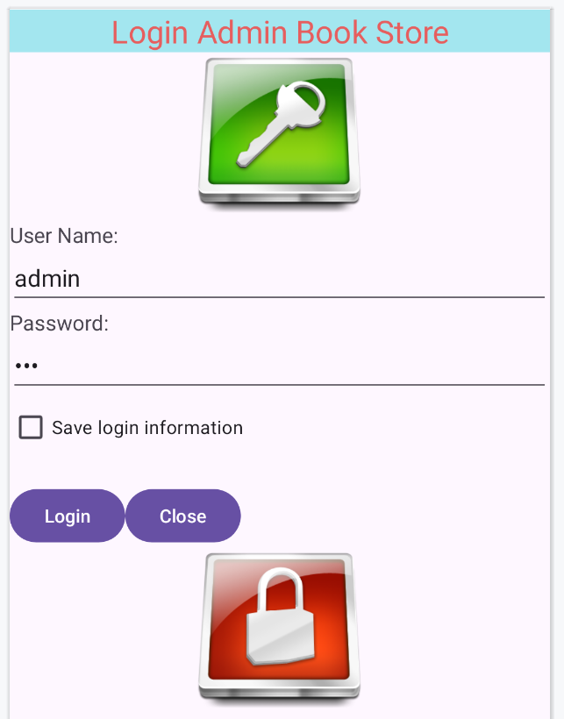
Exercise
Using Broadcast Receiver for Wi-Fi changing, if internet connection is off then disabled Login button as automatically

Slide 21
Discussions
Q1: What are advantages of Broadcast Receiver?
Q2: How to listen Wi-Fi changing?
Q3: How to listen SMS coming?
Q4: How to do custom Broadcast Receiver?
Q5: What are different between registering Broadcast Receiver in Manifest and Java Code?

Slide 22
Next Lesson
Multi-Threading

Slide 23
THANK YOU!

